Slide 1
ICPT – Concepten in Programmeertalen
Les 3b
Scopes
Data types
Expressions & statements

Slide 2
Planning voor deze les
Vragen?
Scopes
Data Types
Expressions and assignment types
Statements

Slide 3
Vragen over de vorige les?

Slide 4
Variable Attributes: Scope
The scope of a variable is the range of statements over which it is visible
The local variables of a program unit are those that are declared in that unit
The nonlocal variables of a program unit are those that are visible in the unit but not declared there
Global variables are a special category of nonlocal variables
The scope rules of a language determine how references to names are associated with variables

Slide 5
Static Scope
Based on program text
To connect a name reference to a variable, you (or the compiler) must find the declaration
Search process: search declarations, first locally, then in increasingly larger enclosing scopes, until one is found for the given name
Enclosing static scopes (to a specific scope) are called its static ancestors; the nearest static ancestor is called a static parent
Some languages allow nested subprogram definitions, which create nested static scopes (e.g., Ada, JavaScript, Common LISP, Scheme, Fortran 2003+, F#, and Python)

Slide 6
Scope (continued)
Variables can be hidden from a unit by having a "closer" variable with the same name
Ada allows access to these "hidden" variables
E.g., unit.name

Slide 7
Blocks
A method of creating static scopes inside program units--from ALGOL 60
Example in C:
void sub() {
int count;
while (...) {
int count;
count++;
...
}
…
}
- Note: legal in C and C++, but not in Java
and C# - too error-prone

Slide 8
Declaration Order
C99, C++, Java, and C# allow variable declarations to appear anywhere a statement can appear
In C99, C++, and Java, the scope of all local variables is from the declaration to the end of the block
In C#, the scope of any variable declared in a block is the whole block, regardless of the position of the declaration in the block
However, a variable still must be declared before it can be used

Slide 9
Declaration Order (continued)
In C++, Java, and C#, variables can be declared in for statements
The scope of such variables is restricted to the for construct

Slide 10
Global Scope
C, C++, PHP, and Python support a program structure that consists of a sequence of function definitions in a file
These languages allow variable declarations to appear outside function definitions
C and C++have both declarations (just attributes) and definitions (attributes and storage)
A declaration outside a function definition specifies that it is defined in another file

Slide 11
Global Scope (continued)
PHP
Programs are embedded in HTML markup documents, in any number of fragments, some statements and some function definitions
The scope of a variable (implicitly) declared in a function is local to the function
The scope of a variable implicitly declared outside functions is from the declaration to the end of the program, but skips over any intervening functions
Global variables can be accessed in a function through the $GLOBALS array or by declaring it global

Slide 12
Global Scope (continued)
Python
A global variable can be referenced in functions, but can be assigned in a function only if it has been declared to be global in the function

Slide 13
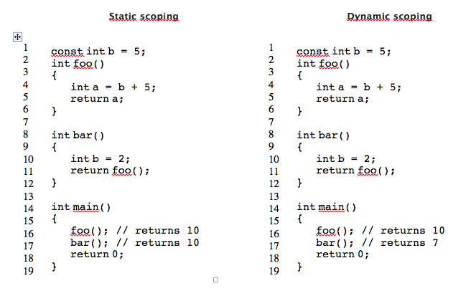
Static versus dynamic scope

Slide 14
Evaluation of Static Scoping
Works well in many situations
Problems:
In most cases, too much access is possible
As a program evolves, the initial structure is destroyed and local variables often become global; subprograms also gravitate toward become global, rather than nested

Slide 15
Evaluation of Dynamic Scoping
Advantage: convenience
Disadvantages:
While a subprogram is executing, its variables are visible to all subprograms it calls
Impossible to statically type check
3. Poor readability- it is not possible to statically
determine the type of a variable

Slide 16
Scope and Lifetime
Scope and lifetime are sometimes closely related, but are different concepts
Consider a static variable in a C or C++ function

Slide 17
Referencing Environments
The referencing environment of a statement is the collection of all names that are visible in the statement
In a static-scoped language, it is the local variables plus all of the visible variables in all of the enclosing scopes
A subprogram is active if its execution has begun but has not yet terminated
In a dynamic-scoped language, the referencing environment is the local variables plus all visible variables in all active subprograms

Slide 18
Named Constants
A named constant is a variable that is bound to a value only when it is bound to storage
Advantages: readability and modifiability
Used to parameterize programs
The binding of values to named constants can be either static (called manifest constants) or dynamic
Languages:
Ada, C++, and Java: expressions of any kind, dynamically bound
C# has two kinds, readonly and const
- the values of const named constants are bound at
compile time
- The values of readonly named constants are
dynamically bound

Slide 19
Summary
Case sensitivity and the relationship of names to special words represent design issues of names
Variables are characterized by the sextuples: name, address, value, type, lifetime, scope
Binding is the association of attributes with program entities
Scalar variables are categorized as: static, stack dynamic, explicit heap dynamic, implicit heap dynamic
Strong typing means detecting all type errors

Slide 20
PAUZE

Slide 21
Datatypes

Slide 22
Datatypes
Wat is de maximale waarde van een int?

Slide 23
In Java
Wat is de maximale waarde van een int?
public class Test {
public static void main(String[] args) {
int a = Integer.MAX_VALUE;
System.out.println(a); //2147483647
a = a+1;
System.out.println(a); //-2147483648
a = a+1;
System.out.println(a); //-2147483647
a = Integer.MAX_VALUE + Integer.MAX_VALUE;
System.out.println(a); //-2
}
}

Slide 24
Op een Arduino?
On the Uno and other ATMEGA based boards, unsigned ints (unsigned integers) are the same as ints in that they store a 2 byte value. Instead of storing negative numbers however they only store positive values, yielding a useful range of 0 to 65,535 (2^16) - 1).
The Due stores a 4 byte (32-bit) value, ranging from 0 to 4,294,967,295 (2^32 - 1).

Slide 25
Pointers
Adres:
-1076858772
Adres:
-1076858774
#include <stdio.h>
int main()
{
int a = 7;
int *ptr;
ptr = &a; //De variabele ptr krijgt het geheugenadres van de variabele a
printf("a: %i\n", a); //7
printf("&a: %i\n", &a); //bv. -1076858772
printf("ptr: %i\n", ptr); //bv. -1076858772 hetzelfde als &a
printf("*ptr: %i\n", *ptr); //7
return(0);
}
Waarde:
7
Waarde:
-1076858772
a
ptr

Slide 26
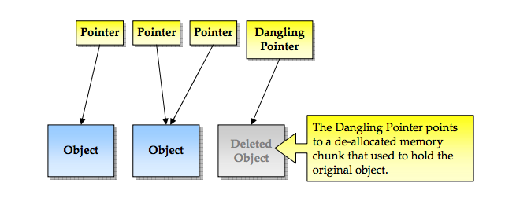
Dangling (bungelende) pointer

Slide 27
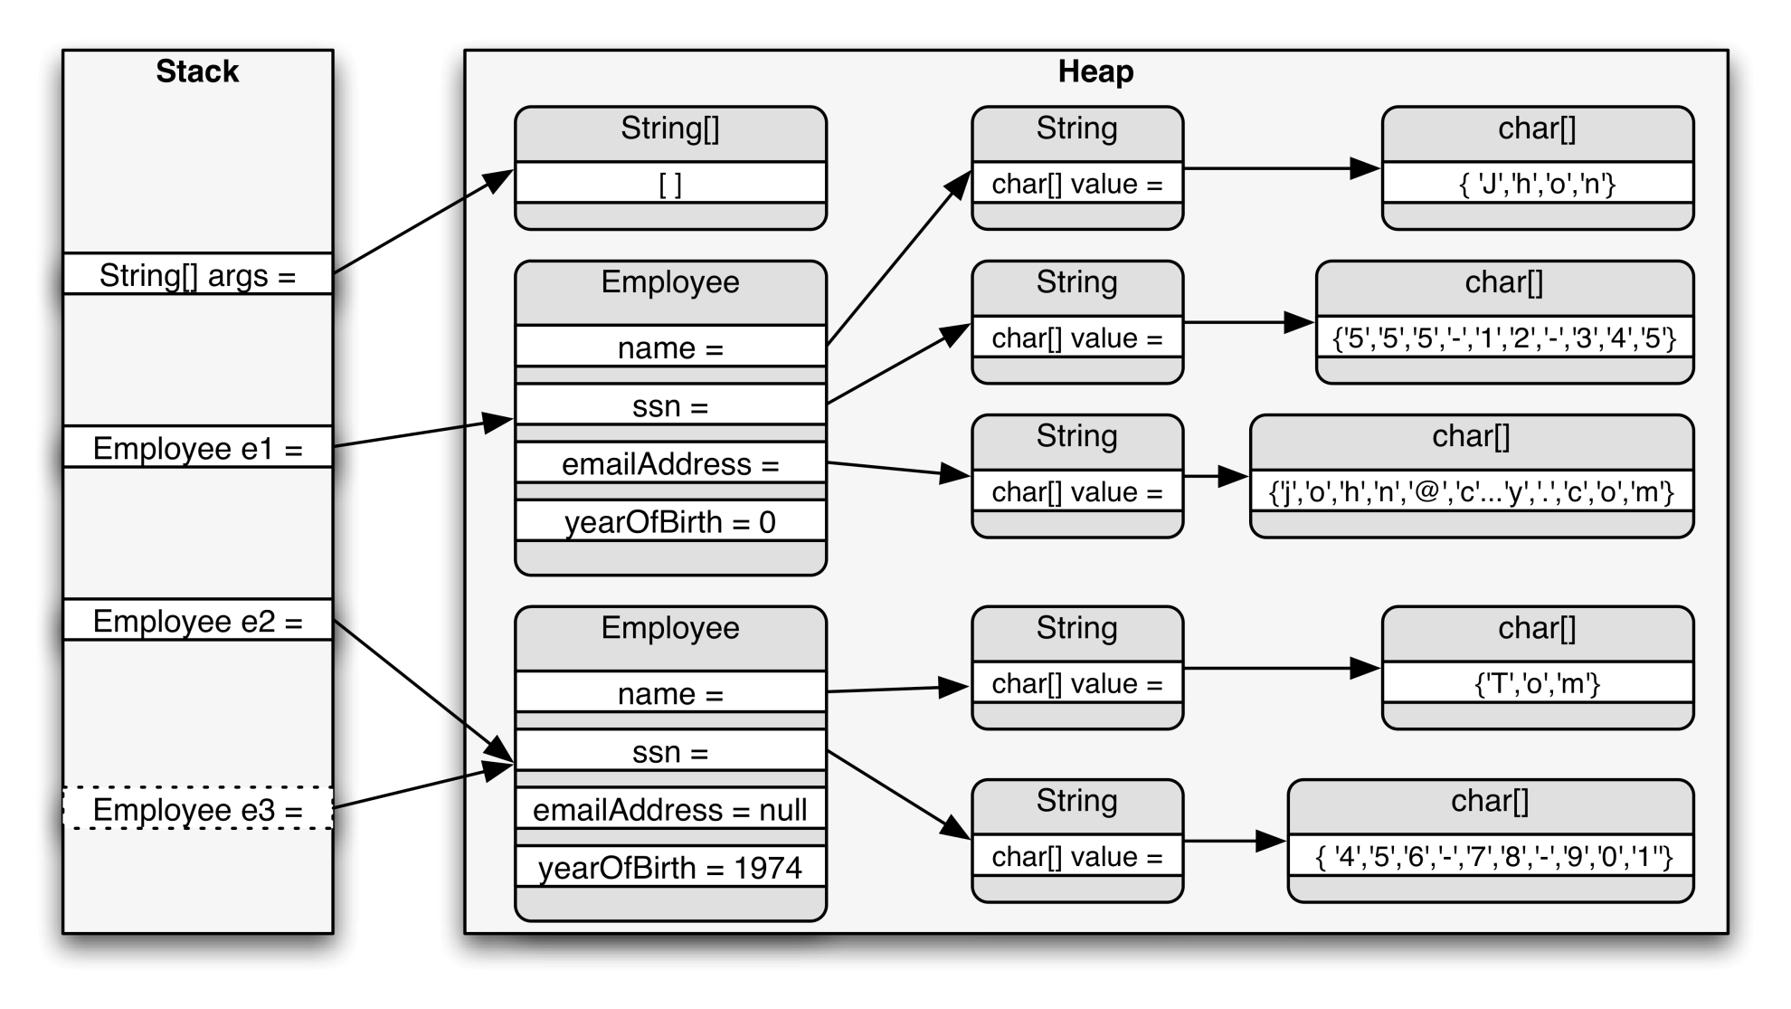
Java memory model

Slide 28
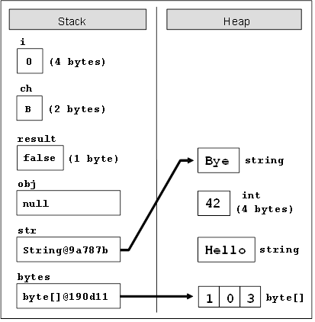
Java stack & heap

Slide 29
public class Test {
public static void main(String[] args) {
Object a = new Object();
Object b = new Object();
a = b;
}
}

Slide 30
public class Test {
public static void main(String[] args) {
String a = "test";
String b = "te".concat("st");
System.out.println("a == b? " + (a == b));
//levert false op
b = b.intern();
System.out.println("a == b? " + (a == b));
//levert true op
b = b+ ”1";
}
}

Slide 31
Operator overloading niet geïmplementeerd
class Point:
def __init__(self,x = 0,y = 0):
self.x = x
self.y = y
----------------------------------------------------
>>> p1 = Point(2,3)
>>> p2 = Point(-1,2)
>>> p1 + p2
Traceback (most recent call last):
...
TypeError: unsupported operand type(s) for +: 'Point' and 'Point'

Slide 32
Operator overloading geïmplementeerd
class Point:
# previous definitions...
def __add__(self,other):
x = self.x + other.x
y = self.y + other.y
return Point(x,y)
----------------------------------------------------
>>> p1 = Point(2,3)
>>> p2 = Point(-1,2)
>>> print(p1 + p2)
(1,5)

